Slide 1

Get Started with Coding:
Working with Visual Studio, Primitives Types and Variables.
PACE Coding Program 2019

Slide 2
Agenda | Objectives
Overview of Visual Studio IDE
How to use variables
01
04
What is a data type?
03
05
Exercises
02
First steps with the console
PACE Coding Program 2019

Slide 3
1.Overview of Visual Studio IDE

Slide 4
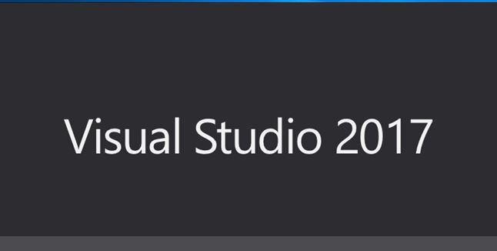
Creating your first application
1. Open Visual Studio IDE
PACE Coding Program 2019
Working with visual studio

Slide 5
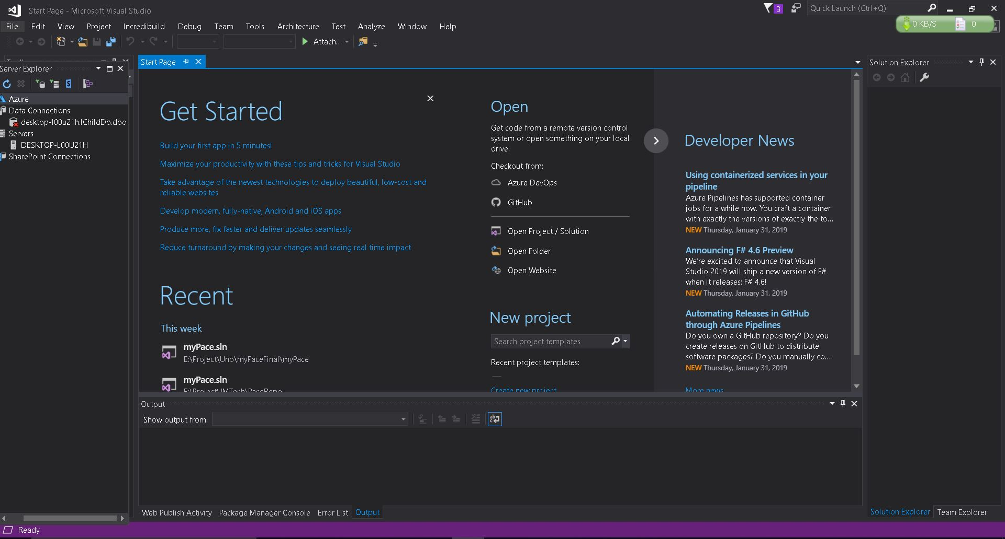
Creating your first application
PACE Coding Program 2019
Working with visual studio

Slide 6
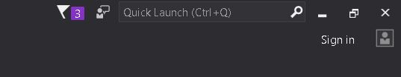
Creating your first application
Up Bar Overview
Menu Bar
Toolbar
Windows Menu
Notifications
Search Field
Signed In User
PACE Coding Program 2019
Working with visual studio

Slide 7
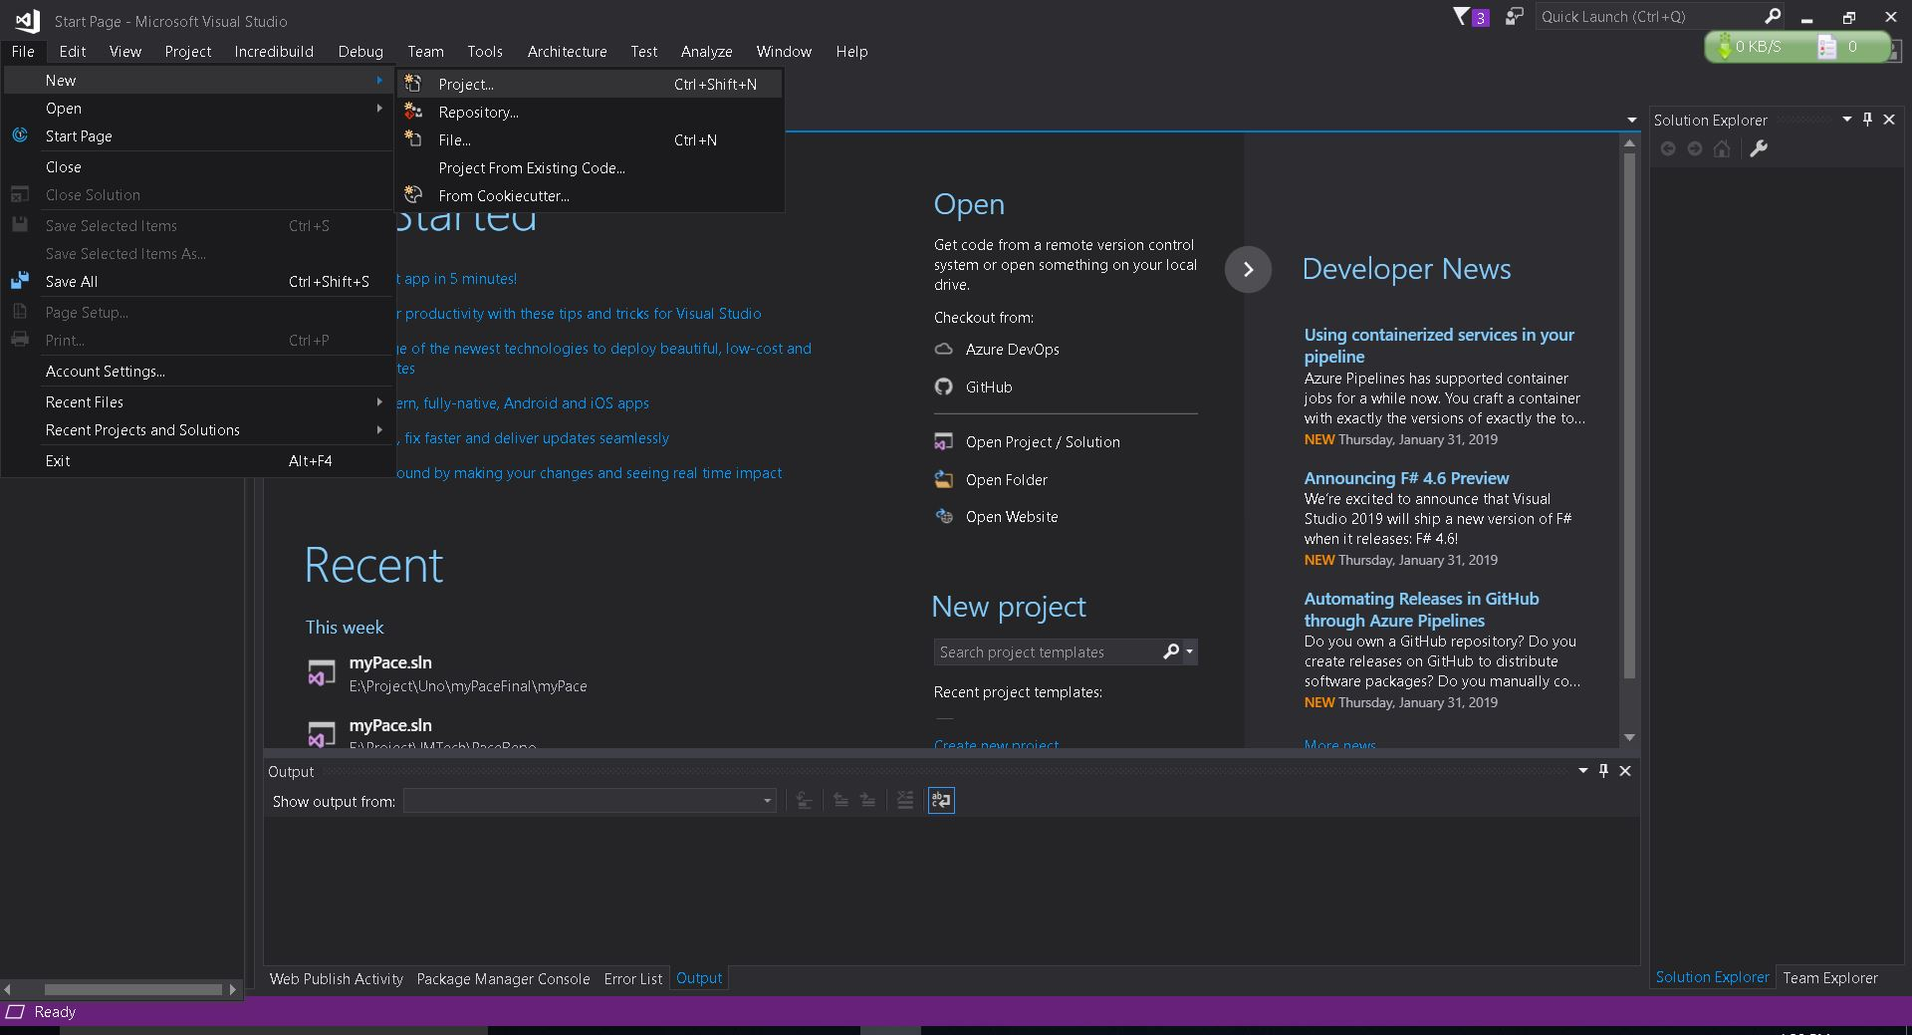
Creating your first application
2. Go to File -> New -> Project
PACE Coding Program 2019
Working with visual studio

Slide 8
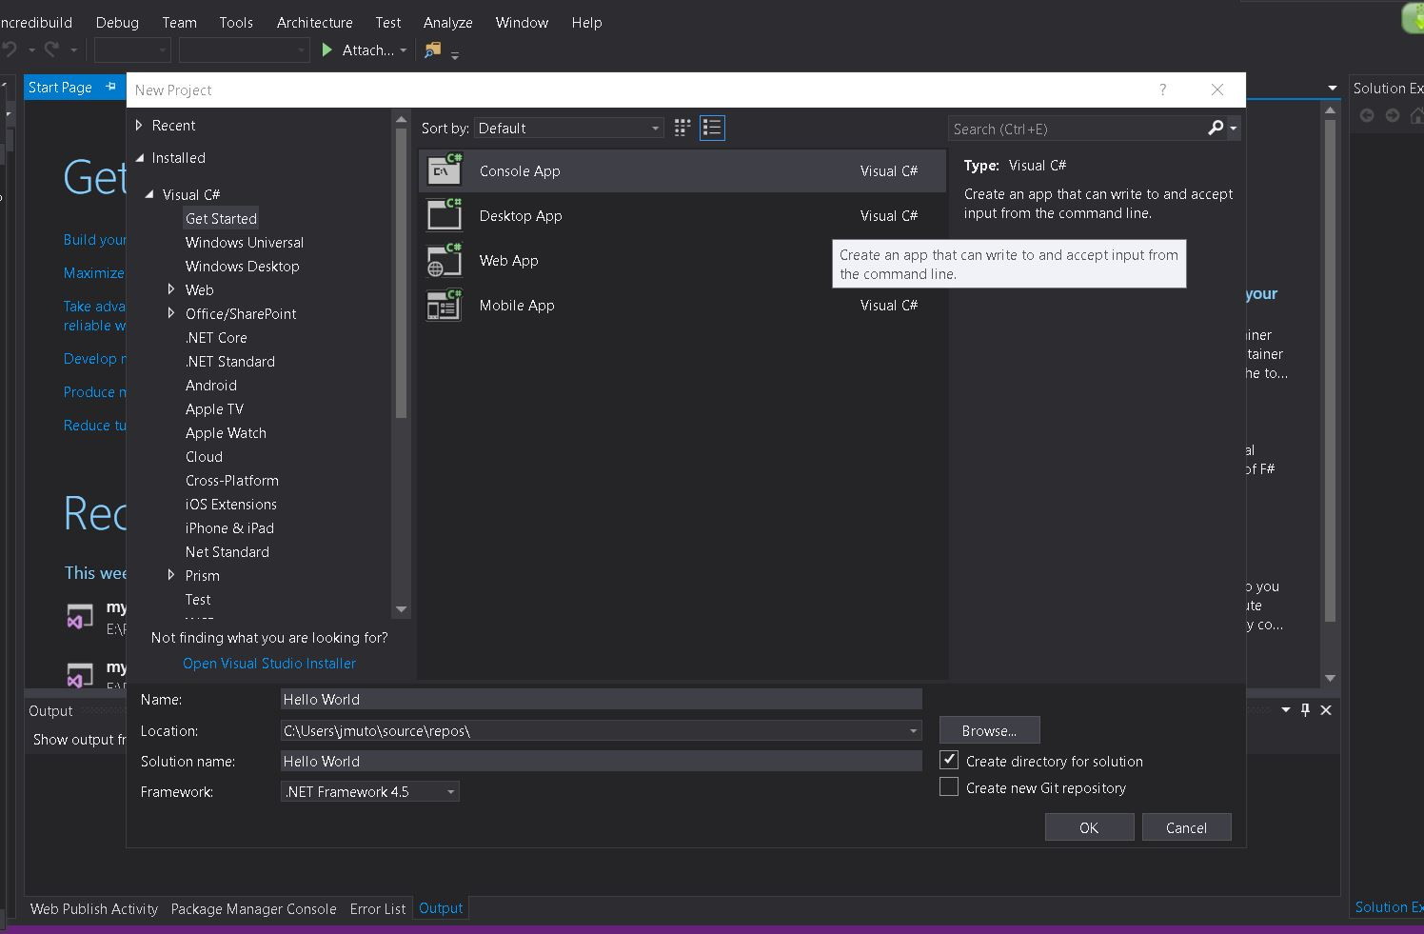
Creating your first application
3. Choose the type of application you want to build
PACE Coding Program 2019
Working with visual studio

Slide 9
Creating your first application
3. Set details for your application
PACE Coding Program 2019
Working with visual studio

Slide 10
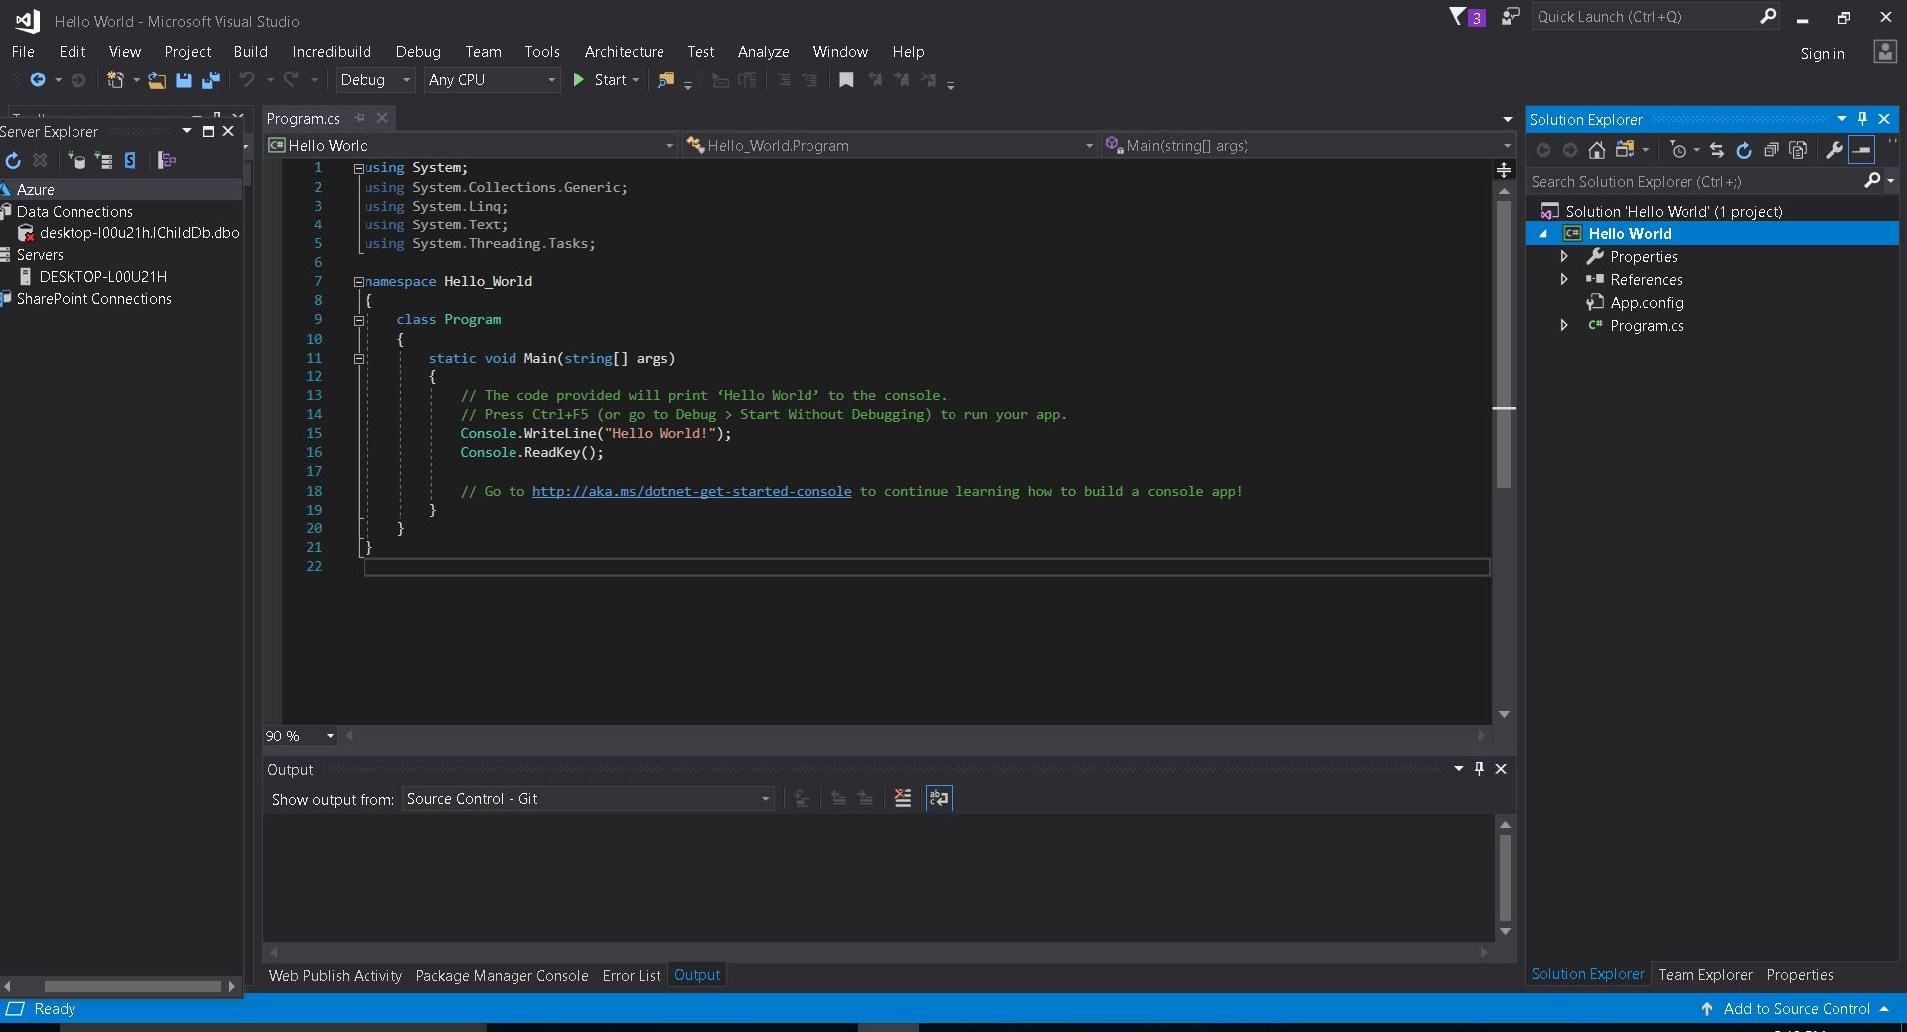
Hello World!
PACE Coding Program 2019
Working with visual studio

Slide 11
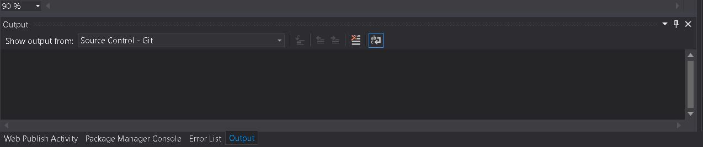
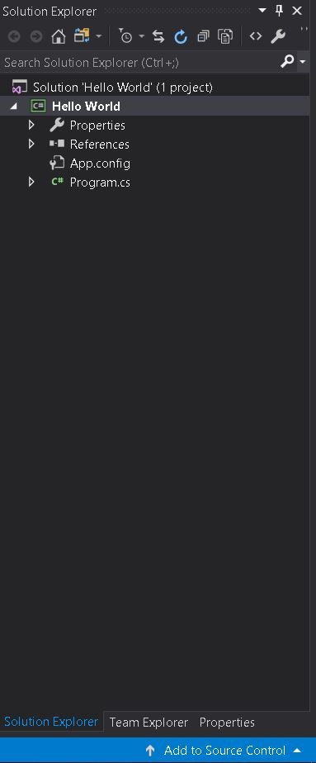
Error - Solution Explorer
Error Output
Solution Explorer
PACE Coding Program 2019
Working with visual studio

Slide 12
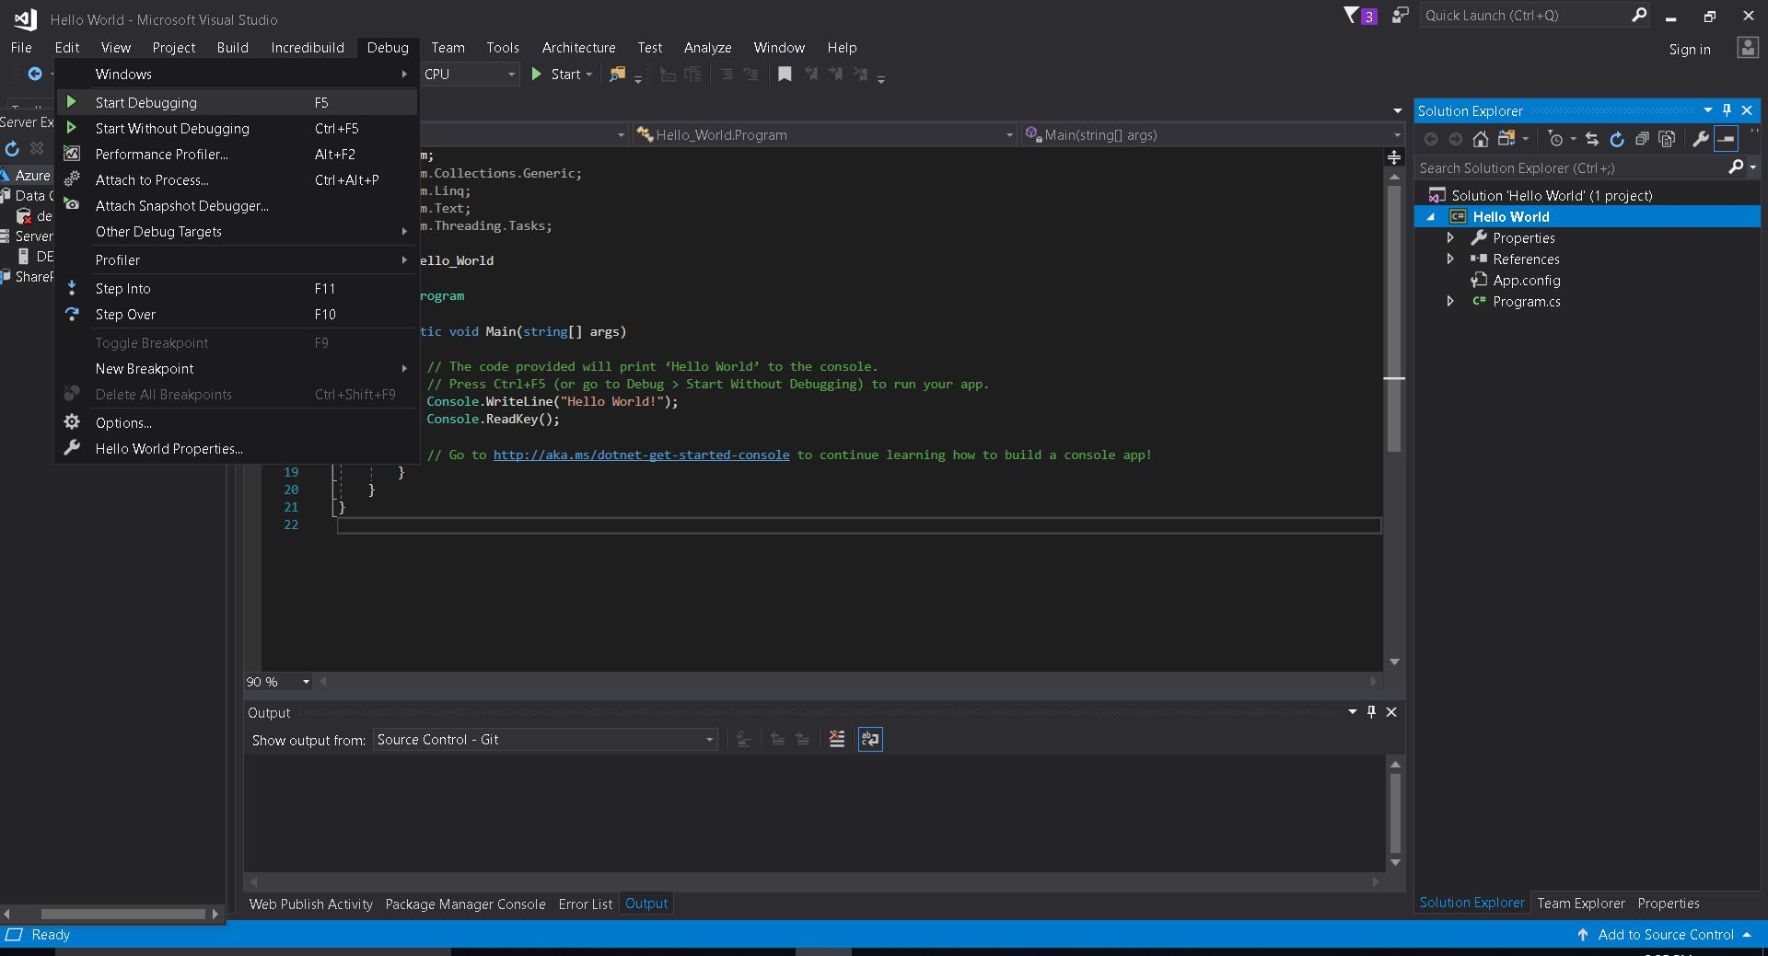
Run your application
Go to Debug -> Start Debugging
PACE Coding Program 2019
Working with visual studio
Notes:
-Talk about debugging
-Talk about start debuggung

Slide 13
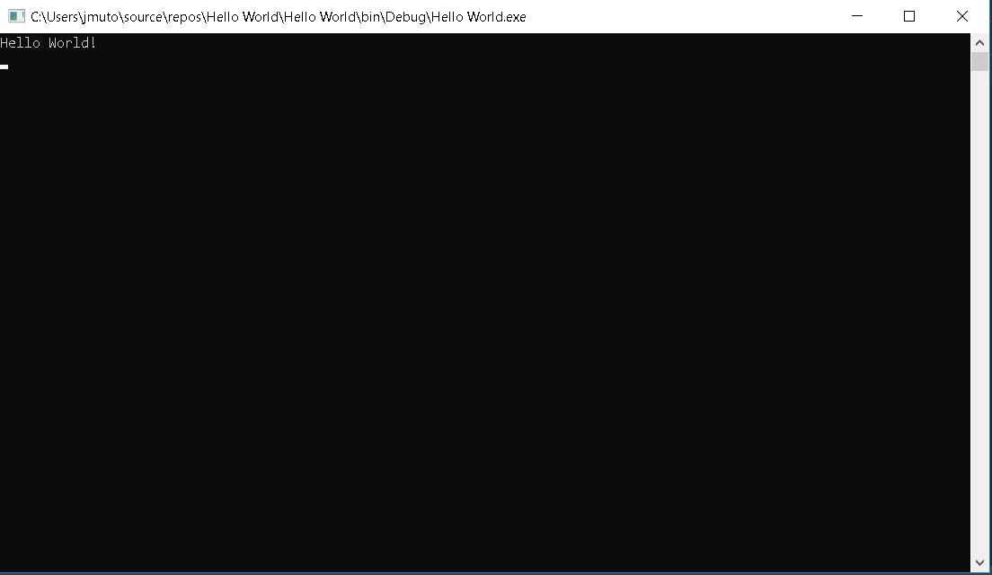
Hello World!
PACE Coding Program 2019
Working with visual studio

Slide 14
Exercise

Slide 15
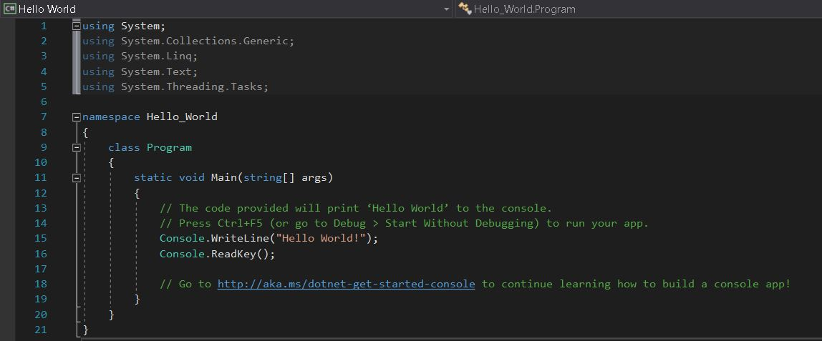
Structure of a C# program
Importing libraries
Defining a location
Defining a class
Entry point of the program
Comments
PACE Coding Program 2019
Working with visual studio
Notes:
-Every line of code ends mostly with a semicolon

Slide 16
Comments
Inline comment
//This is a comment
//This code is not executed by the compiler
Multiline comment
/* This a comment
* on multiple lines
* !
*/
PACE Coding Program 2019
Working with visual studio

Slide 17
2. First steps with the console

Slide 18

What is a console?
PACE Coding Program 2019
First steps with the console

Slide 19
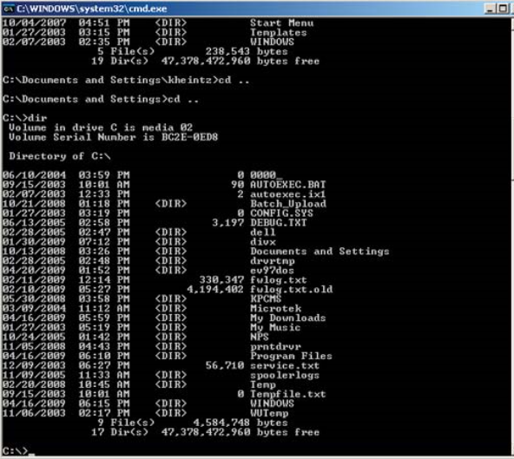
What is a console?
The console, also called "command prompt " or "Shell " is a black-bottomed window (usually) in which you enter text commands to execute (this program is located here: C:Windows/System32/cmd.exe).
*It is not Xbox or PS4
PACE Coding Program 2019
First steps with the console

Slide 20
Printing to the console
To be able to write something on the console using Visual studio, you need to:
Import System library (using System;)
Console.Write(what you want to write);
Console.WriteLine(what you want to write); prints on one single line and starts a new line.
PACE Coding Program 2019
First steps with the console

Slide 21
Reading from the console
To be able to read an input from the console, you need to:
Import System library(using System;)
Console.ReadLine();
PACE Coding Program 2019
First steps with the console

Slide 22
Demo

Slide 23
3. Data Types

Slide 24
What is a data type?
A type of data
That specifies which type of value a variable has,
and what type of operations can be applied to it.
e.g. A string is a data type that classify text; an integer is a data type used to classify whole numbers.
PACE Coding Program 2019
Data Types

Slide 25
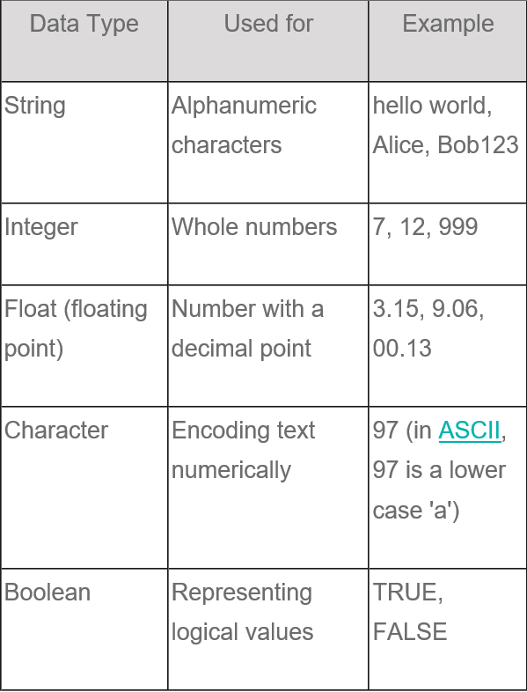
Sample types…
PACE Coding Program 2019
Data Types

Slide 26
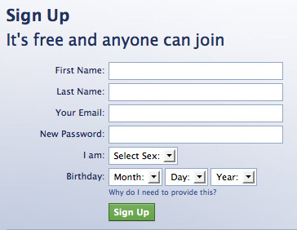
Is this familiar?
PACE Coding Program 2019
Data Types

Slide 27
Characteristics
Data types are characterized by:
Name – for example, int; -
Size (how much memory they use) – for example, 4 bytes;
Default value – for example 0.
PACE Coding Program 2019
Data Types

Slide 28
Types
Basic data types in C# are distributed into the following types:
Integer types – sbyte, byte, short, ushort, int, uint, long, ulong;
Real floating-point types – float, double;
Real type with decimal precision – decimal;
Boolean type – bool;
Character type – char;
String – string;
Object type – object.
PACE Coding Program 2019
Data Types

Slide 29
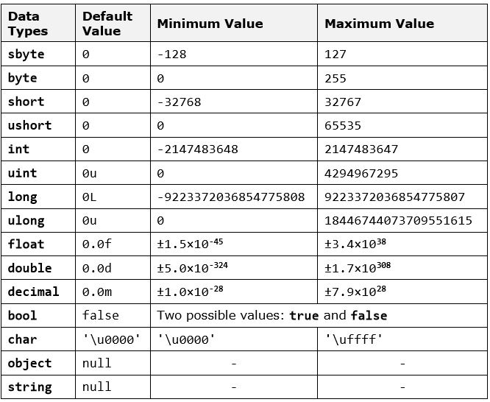
Check out this…
PACE Coding Program 2019
Data Types

Slide 30
Types
PACE Coding Program 2019
Data Types

Slide 31
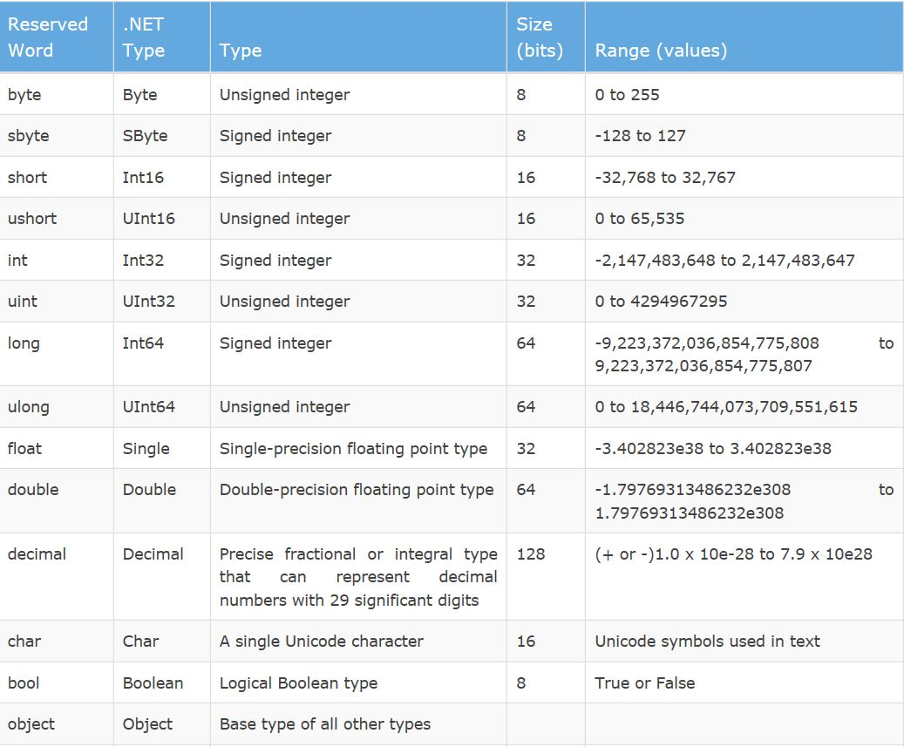
Types
PACE Coding Program 2019
Data Types

Slide 32
4. Using variables

Slide 33
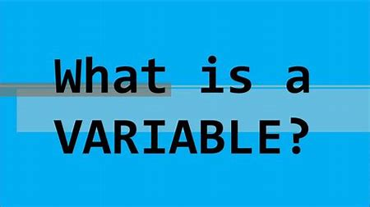
What is a variable?
PACE Coding Program 2019
Data Types

Slide 34
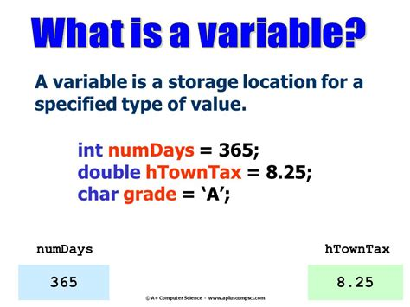
PACE Coding Program 2019
Data Types

Slide 35
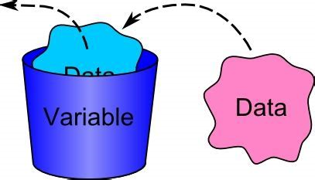
What is a variable?
PACE Coding Program 2019
Data Types

Slide 36
Variables
A variable is a container of information, which can change its value.
It provides means for:
storing information
retrieving the stored information
modifying the stored information.
In C# programming, you will use variables to store and process information all the time.
PACE Coding Program 2019
How to use variables

Slide 37
Characteristics
Variables are characterized by:
type (of the information preserved in them), for example int
name (identifier), for example age,
value (stored information), for example 25.
PACE Coding Program 2019
How to use variables

Slide 38
Naming variable rules
The name of the variable can be any of our choice but must follow certain Rules defined in the C# language specification: -
Variable names can contain the letters a-z, A-Z, the digits 0-9 as well as the character '_'.
Variable names cannot start with a digit.
Variable names cannot coincide with a keyword of the C# language. For example, base, char, default, int, object, this, null and many others cannot be used as variable names.
PACE Coding Program 2019
How to use variables

Slide 39
Naming variable examples
Proper names:
name
first_Name
_name1
lastName
Improper names (will lead to compilation error):
1 (digit)
if (keyword)
1name (starts with a digit)
PACE Coding Program 2019
How to use variables

Slide 40
Declaring variables
When you declare a variable, you perform the following steps:
specify its type (such as int)
specify its name (identifier, such as age); -
optionally specify initial value (such as 25) but this is not obligatory.
PACE Coding Program 2019
How to use variables

Slide 41
Declaring variables
The syntax for declaring variables in C# is as follows:
Here is an example of declaring variables:
string name;
int age;
<data type> <identifier> [= <initialization>];
PACE Coding Program 2019
How to use variables

Slide 42
Assigning a Value
Assigning a value to a variable is the act of providing a value that must be stored in the variable. This operation is performed by the assignment operator "=". On the left side of the operator we put the variable name and on the right side – its new value.
name = “Victor Odhiambo”;
age = 25;
PACE Coding Program 2019
How to use variables

Slide 43
Initialization of Variables
The word initialization in programming means specifying an initial value. When setting value to variables at the time of their declaration we actually initialize them.
string name = “Victor Odhiambo”;
int age = 25;
PACE Coding Program 2019
How to use variables

Slide 44
Questions ?

Slide 45
Video summary
https://www.youtube.com/watch?v=BcP6QozQRPc

Slide 46
Exercises

Slide 47
Exercise 1
What is the output of this code:
Console.WriteLine(“One line of code”);
A.”One line of code”
B. One line of code
C. (“One line of code”)
PACE Coding Program 2019
How to use variables

Slide 48
Exercise 2
What is the output of this code:
Console.Write(“Mum is coming “);
Console.WriteLine(“from Mombasa”);
A.Mum is coming
from Mombasa
B.Mum is coming from Mombasa
C. “Mum is coming
from Mombasa”
PACE Coding Program 2019
How to use variables

Slide 49
Exercise 3
Write a program that outputs the example below:
Pace Coding
Program
2019
PACE Coding Program 2019
How to use variables

Slide 50
Exercise 4
Write C# code to display the asterisk pattern as shown below:
*****
*****
*****
*****
*****
PACE Coding Program 2019
How to use variables

Slide 51
Exercise 5
Declare a variable that stores your names.
PACE Coding Program 2019
How to use variables

Slide 52
Exercise 6
Specify the type of the following variables:
l = “myname”;
n = 0.0;
d = 235;
b = true;
m = ‘a’;
PACE Coding Program 2019
How to use variables

Slide 53
Exercise 7
Write a program that stores your names and display the following output:
Hello [my names]
PACE Coding Program 2019
How to use variables

Slide 54
Exercise 8
Write a program that stores your names and display the following output:
Hello [Jane] and [Jonh]
PACE Coding Program 2019
How to use variables

Slide 55
Exercise 9
What is the output of this code:
int numberOfStudents = 20;
Console.WriteLine(“Our class has “+ numberOfStudents +” students);
A. Our class has numberOfStudents students
B.”Our class has” + numberOfStudents + “students”
C. Our class has 20 students
PACE Coding Program 2019
How to use variables

Slide 56
Exercise 10
Write a program that stores the number of students, girls and boys in a class. The output of the program is shown below:
Our class has 20 students with 9 boys and 11 girls.
PACE Coding Program 2019
How to use variables

Slide 57
Exercise 11
Write a program that stores the number of students, girls and boys in a class. The output of the program is shown below:
Our class has 20 students with:
-9 boys and
-11 girls.
PACE Coding Program 2019
How to use variables

Slide 58
Assignment 1
Write C# code to declare a variable to store the age of a person. Then the output of the program is as an example shown below:
You are 20 years old.
PACE Coding Program 2019
How to use variables

Slide 59
Assignment 1
Write C# code to declare a variable to store the age of a person. Then the output of the program is as an example shown below:
You are 20 years old.
PACE Coding Program 2019
How to use variables

Slide 60
Assignment 2
Write C# code to prompt a user to input his/her name and then the output will be shown as an example below:
Hello John!
PACE Coding Program 2019
How to use variables

Slide 61
Assignment 3
Write C# code to declare two integer variables, one float variable, and one string variable and assign 10, 12.5, and "C# programming" to them respectively. Then display their values on the screen.
PACE Coding Program 2019
How to use variables

Slide 62
Resources
https://www.w3resource.com/csharp-exercises/
http://www.worldbestlearningcenter.com/index_files/csharp-variables-exercises.htm
https://www.csharp-console-examples.com/general/c-exercises-for-beginners/
PACE Coding Program 2019
How to use variables
Notes:
-Example of whatsapp chat message for a variable
-Example of when registering on Facebook

Slide 63
The end
☺
By :Jack Mutobu
:Ooko Emmanuel

